Slide 1
Deep Anomaly Detection using Network Features
RS Ball, HA Kruger, L Drevin
50th ORSSA Conference in collaboration with AFROS
Vaal Triangle Chapter, South Africa
September 12-15, 2021

Slide 2
Introduction
Aim of the research is to create a unified system for detecting anomalies in a transactional setting, as well as to introduce network metrics as a possible extention of traditional transactional features in an AD context
Intention is to develop processes that make unsupervised learning useable within an operational context

Slide 3
Motivation
Motivation is founded in the observation that AD projects can fail due to a:
Lack of interpretability
Lack of effective evaluation techniques
Unified approach provides practitioners with the following:
A means of constructing a performant architecture
An evaluation approach that considers multiple performance metrics for highly imbalanced classes
Produces an output in the form of a probability score
Includes a network metric extension of the unified approach

Slide 4
Structure of the study
Begins with background on the use of autoencoders for anomaly detection
Presentation of transactional data used for experimental research
Implementing the proposed unified approach
Presentation of network data
Implementing a 2nd pass of unified approach using network data
Discussion of the results
Conclusion of the study

Slide 5
Transactional Data
Study uses a data set sourced from an organisation in the financial services industry
Organisation services more than 6m customers
Data is aggregated at the user level and reflects their transactional behaviour
120,676 records, with 47 columns (features)
This is a fraud detection problem, where only 439 users are classified as fraudulent
Severe class imbalance with 0.36% attributed to the minority class

Slide 6
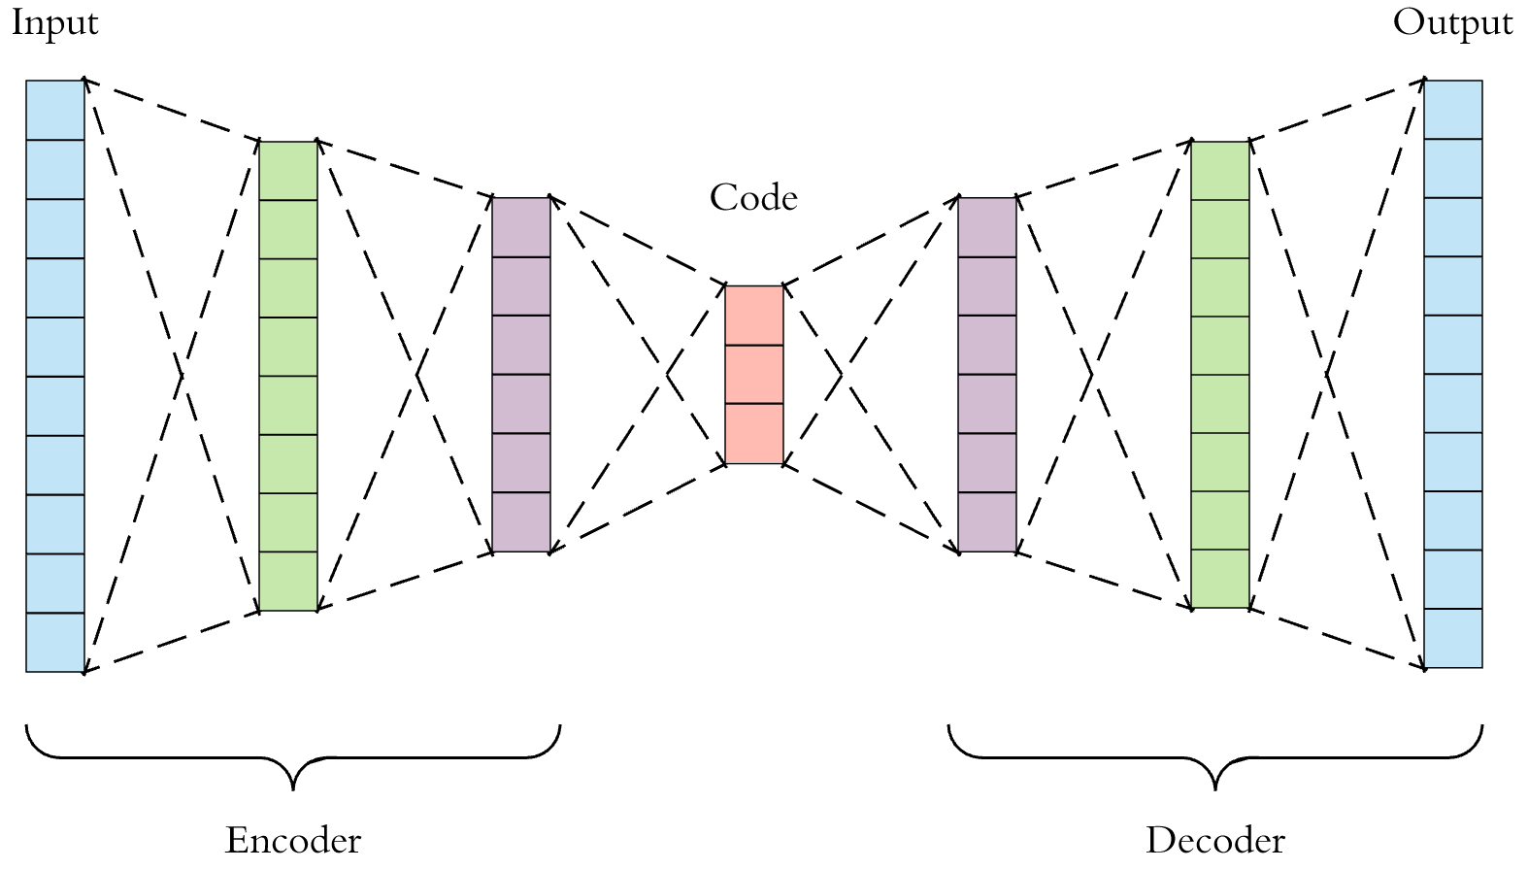
Autoencoders for Anomaly Detection
Classes in an anomaly detection problem are typically highly imbalanced in nature
Unsupervised learning techniques such as autoencoders have been proven to be effective in detecting anomalies in highly imbalanced data
A neural network trained to copy its input to its output
Contains a hidden layer h that generates a function used to learn the model input
Two distinct parts, an encoder and a decoder
Decoder attempts to produce a reconstruction of the input

Slide 7
Methodology: Unified Approach
The Unified Approach to Anomaly Detection was proposed by Ball et. al., 2020
Involves the following:
Neural Architecture Search
Threshold optimisation
Gaussian scaling

Slide 8
Methodology: Neural Architecture Search
Automatically generates neural network architectures
Process involves defining:
Search space
Search strategy
Performance estimation strategy
Search space
Random depth
Random number of nodes
Upper bound for input layer
Same regularisation constraints placed on each candidate architecture

Slide 9
Methodology: Neural Architecture Search
Search strategy
Simulating the search for m iterations
Performance estimation strategy
Defined by using a balanced score comprised of the most relevant metrics for AD
Normalised Matthews Correlation Coefficient
Average Precision
Area Under the ROC Curve

Slide 10
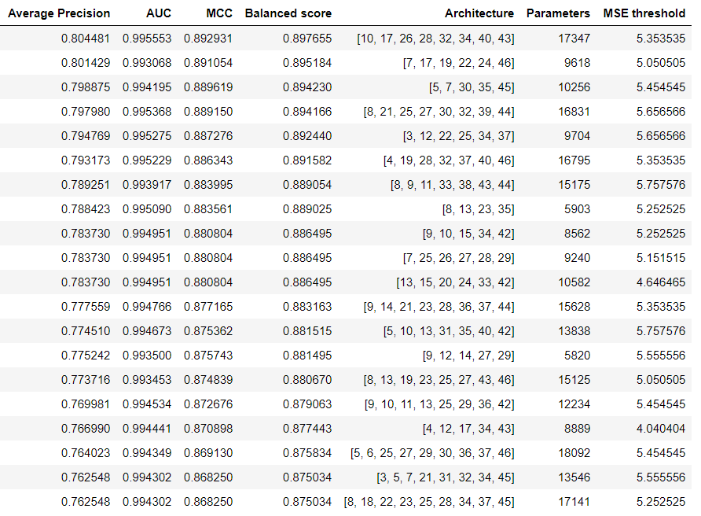
Methodology: Neural Architecture Search
Ran 100 iterations
Optimal architecture has a balanced score of just under 90%
Top 20 architectures (right)
Worst performing architecture had a balanced score below 45%

Slide 11
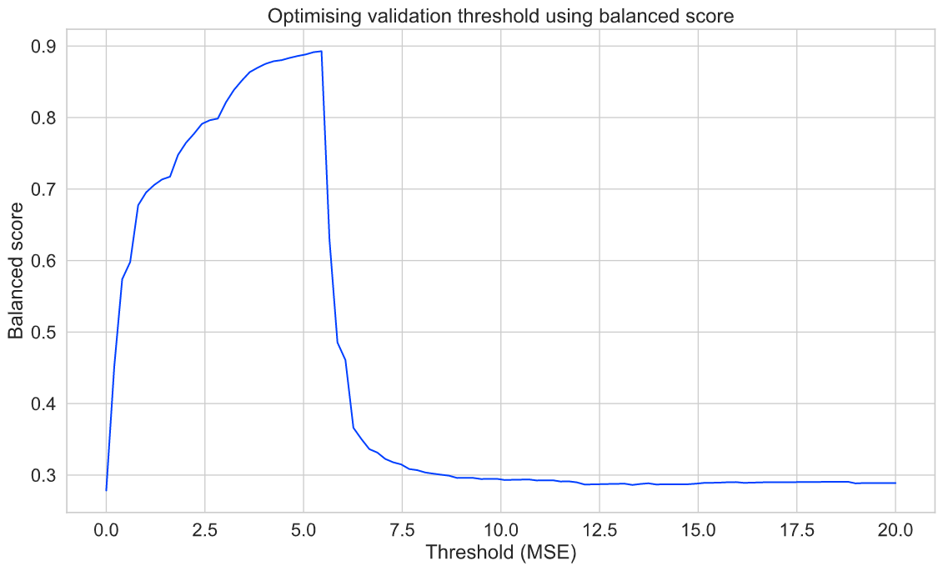
Methodology: Threshold Optimisation
Determination of a threshold for the binary classification threshold in AD is typically subjective
A method to determine the optimal threshold is presented
The maximum balanced score is determined over a linearly spaced vector of mean square error values

Slide 12
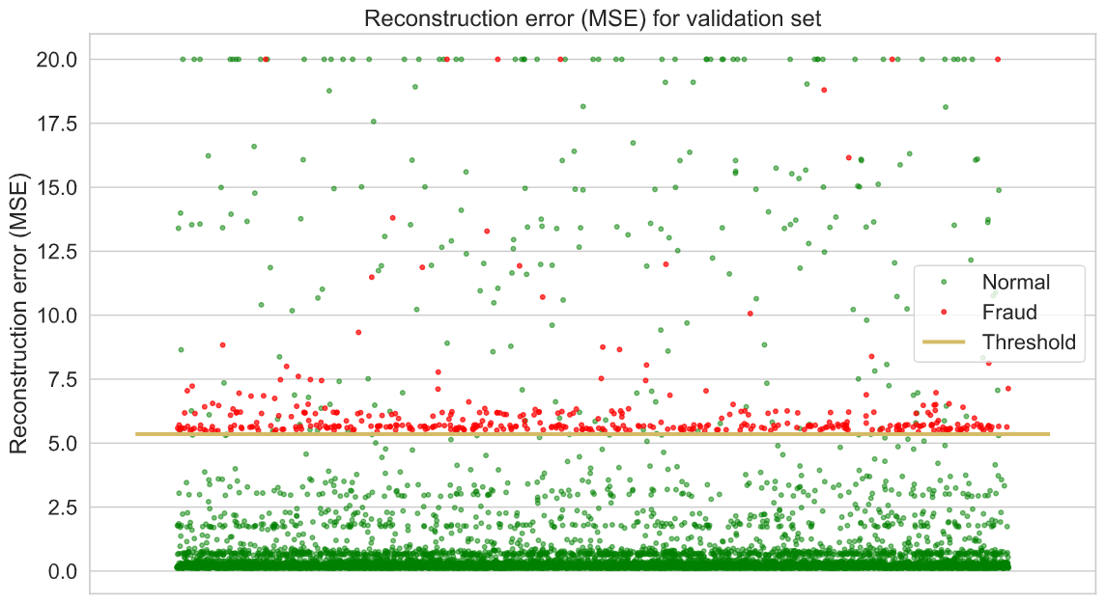
Threshold Optimisation
Optimal validation threshold in gold
Attempts to split the red samples (anomalies) from the green samples (non anomalies)
Red samples generally have a higher MSE and tend upward
Green samples have a lower MSE
Upper cap of 20 is applied for visualisation purposes

Slide 13
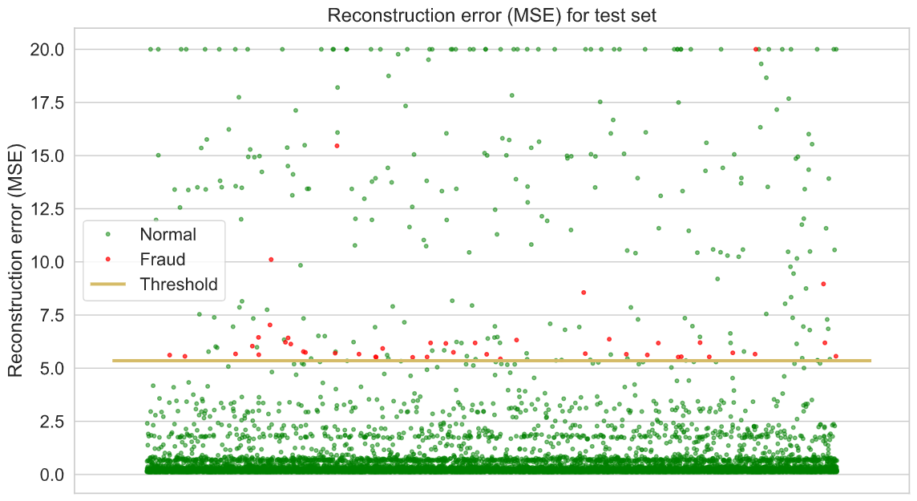
Threshold Optimisation
The optimal threshold is then applied to the holdout test set
The threshold generalises well and captures the anomalies while not misclassifying too many normal transactions

Slide 14
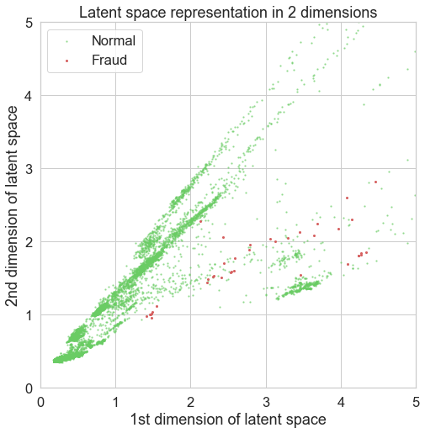
Latent Representation
Illustrating that the model effectively discriminates between the classes
Compressed the data down into a bottleneck with only 2 nodes
Latent representation shows some degree of separation between the classes

Slide 15
Methodology: Gaussian Scaling
Output of model is anomaly score (MSE) per transaction
Not easily interpretable i.e. what does a MSE of 100 represent?
Easier if anomaly scores were in a probability range from 0 to 1
According to studies, Gaussian scaling is a good approach for scaling of most anomaly scores

Slide 16
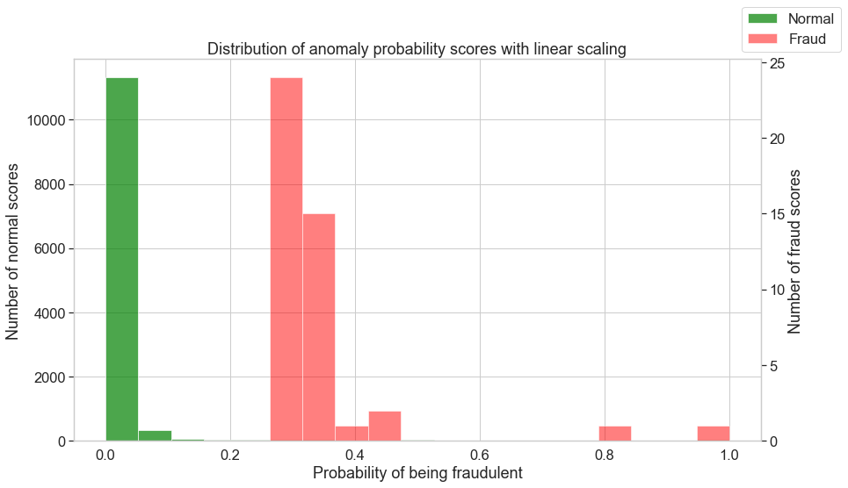
Linear Scaling
Distribution of anomaly scores with linear scaling
Some discrimination between the distributions exists
Non anomalies in green (left axis as reference)
Anomalies in red (right axis as reference)

Slide 17
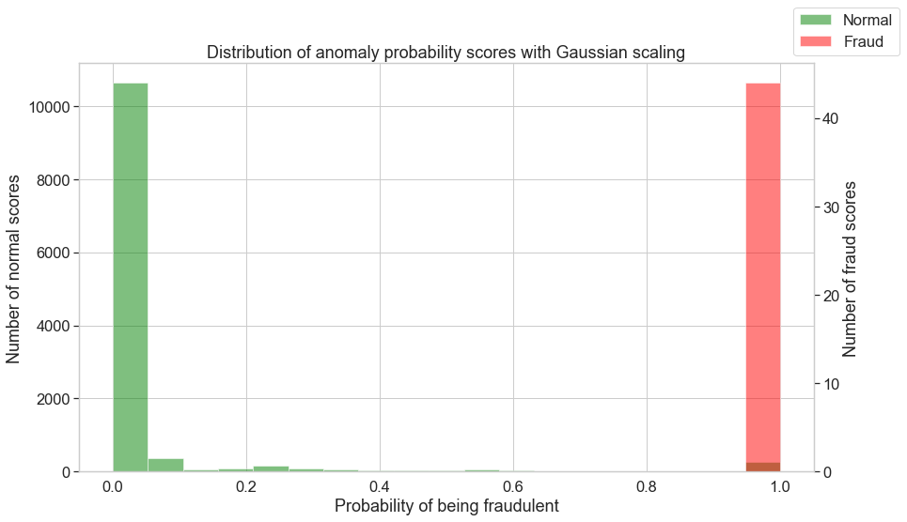
Gaussian Scaling
Distribution of anomaly scores with Gaussian scaling applied
Far greater level of discrimination between the distributions when compared with linear scaling
Superior split with majority of the anomalies

Slide 18
Motivation for using Network Data
Research question: “Can network metrics be used to improve our understanding of user interactions for AD purposes?”
Understand the underlying relationships between users which is not possible by just looking at the transactional data
To try and improve the accuracy of the model
To try and identify additional variables that may influence the model

Slide 19
Motivation for using Network Data
Various attempts have been made to include network-based features when constructing predictive models in an anomaly detection context.
Vlasselaer et al., (2015) were successful in combining transactional features with network-based features in their APATE approach. The authors found that the two sets of features worked well together and complemented one another in improving the performance of their models.
Bonilla (2018) also achieved superior performance of their models when including network metric features in their blockchain fraud detection research.

Slide 20
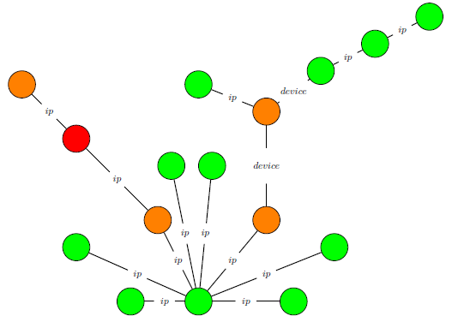
Network Data
A secondary data set then sourced from the same organisation
Contains links (edges) between users (nodes), based on shared IP addresses, devices, or credit cards.
Example of subgraph on right.
Red indicates confirmed fraud, orange are locked/suspicious users, and green are normal users.

Slide 21
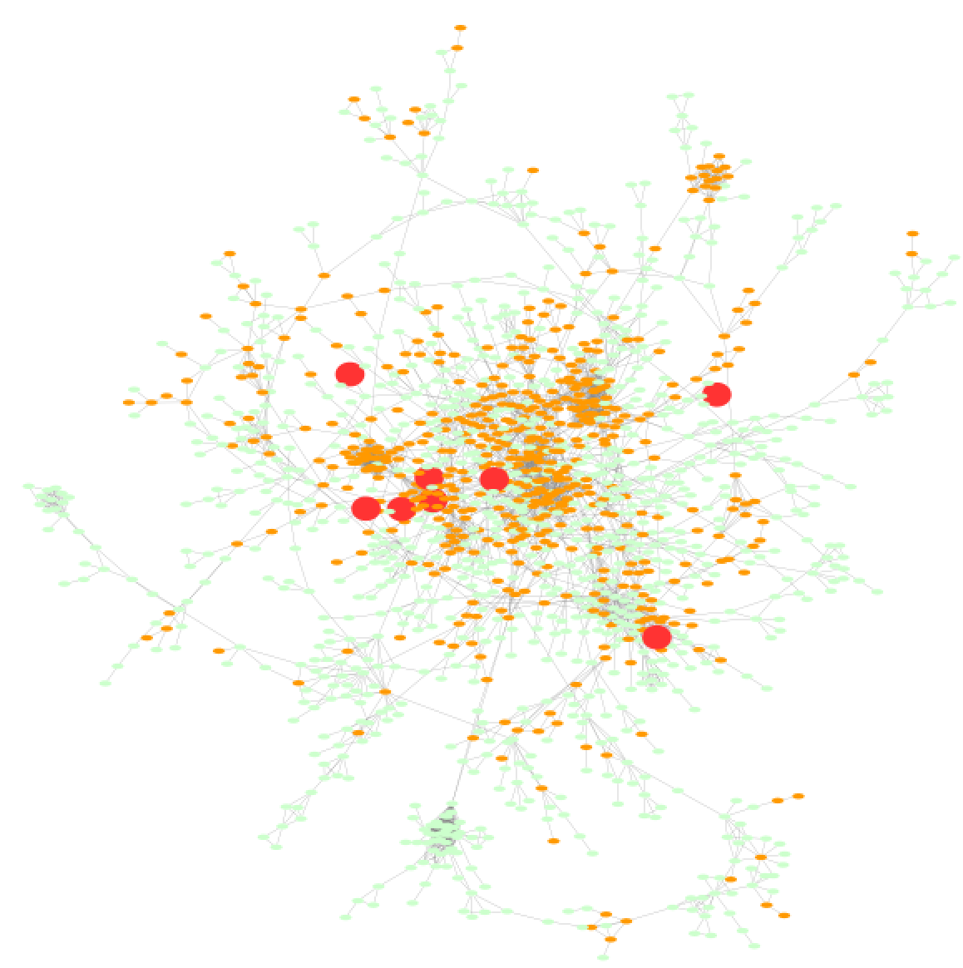
Network Data
Of the 120,676 users in the transactional data set, only 27,361 appear in the network data set.
Example of the biggest cluster to the right, with 1,515 unique users.
Some studies have shown success in combining transactional features with network features.

Slide 22
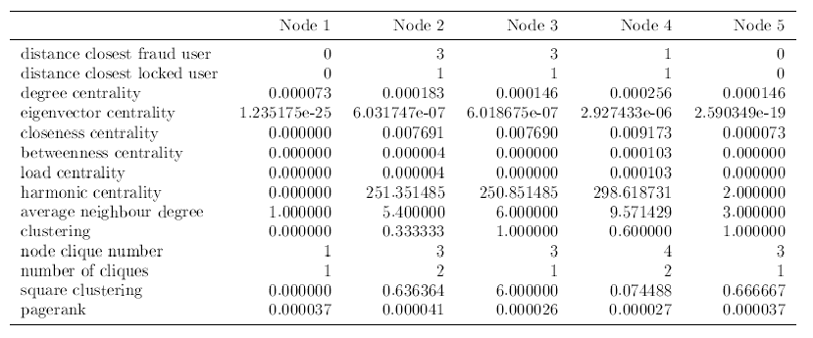
Network Metrics
14 additional features calculated
Can these be used to improve the traditional transactional features
Network features are sparse as links between users are generally considered suspicious i.e. there is no guarantee that all users in the original data set have links to other users
Example to right; first 5 samples

Slide 23
Unified Approach including Network Metrics
Unified approach applied a second time, including the network metric features.
The intention is to determine the optimal architecture from 100 iterations of NAS.
Then compare and see if the network metric features are significant contributors to model performance.

Slide 24
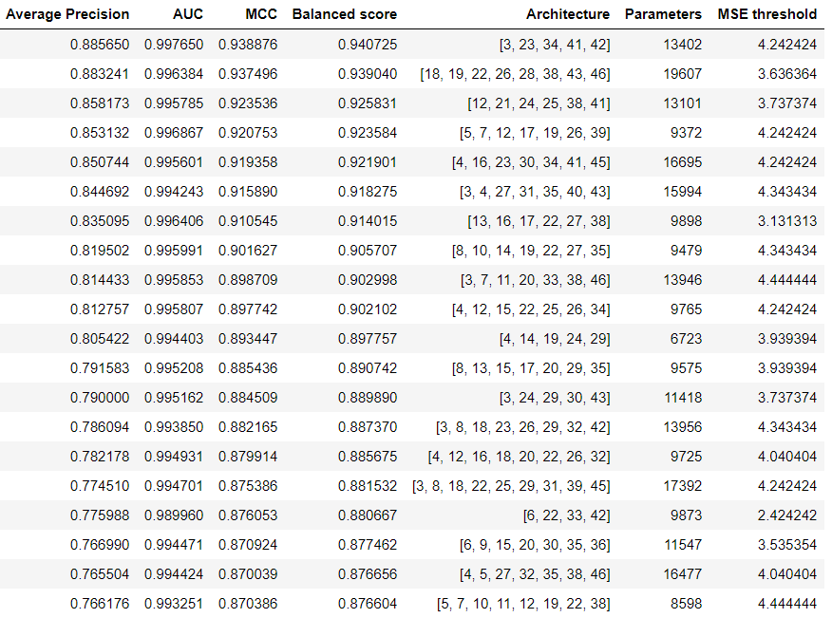
Neural Architecture Search
Optimal architecture achieved a balanced score of over 94%
Contained 9 hidden layers, including the bottleneck
13,402 tuneable parameters

Slide 25
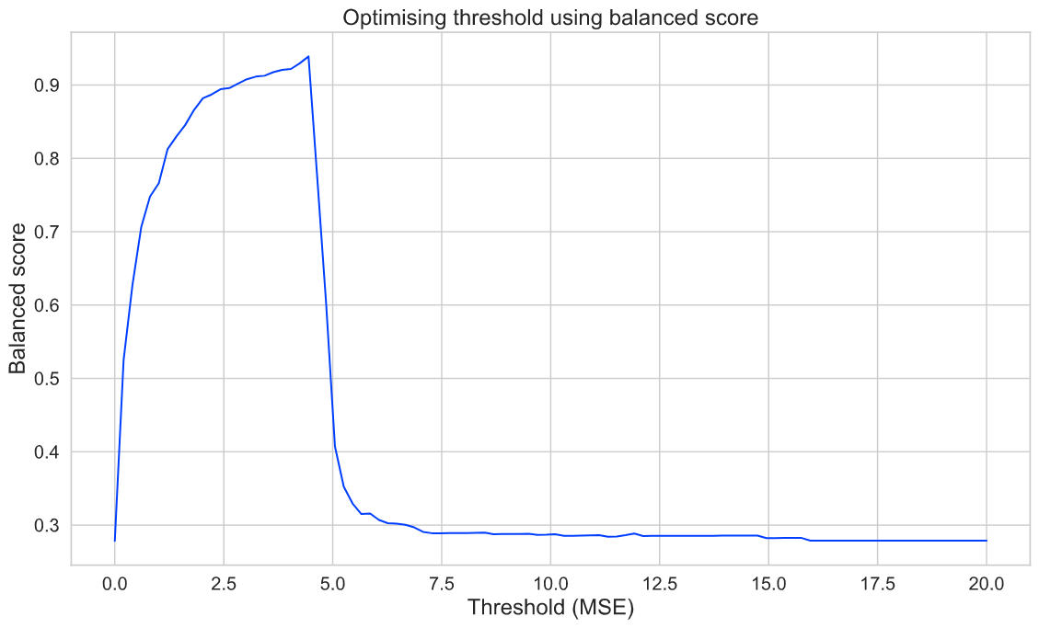
Threshold Optimisation
Optimal threshold was determined at a slightly lower mark for the second optimal model (4.545)

Slide 26
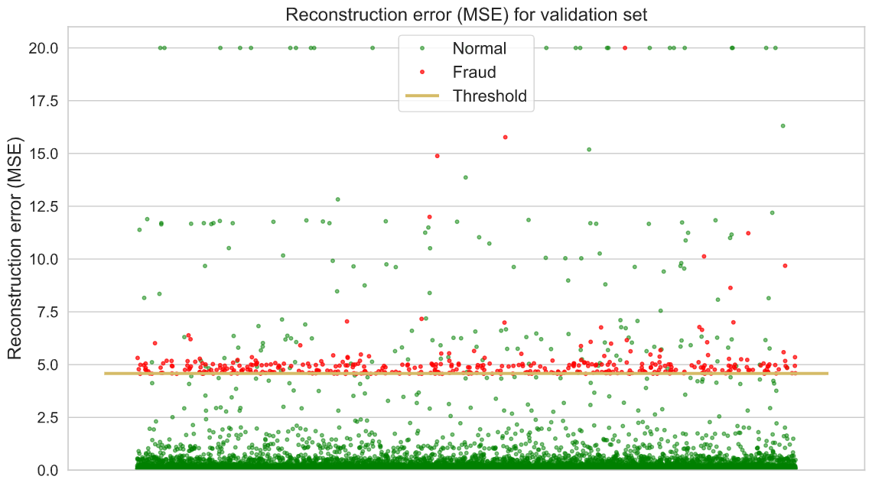
Threshold Optimisation
Threshold appears to split the anomalous/normal data adequately on the validation set

Slide 27
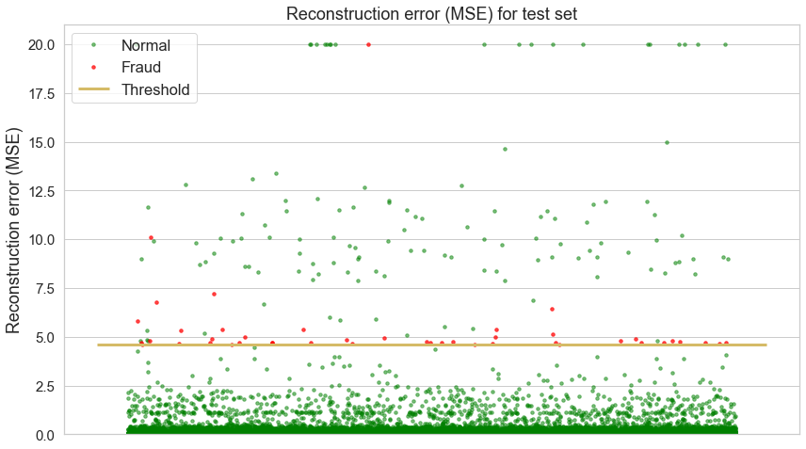
Threshold Optimisation
The same threshold also splits the anomalies/normal data well using the test set

Slide 28
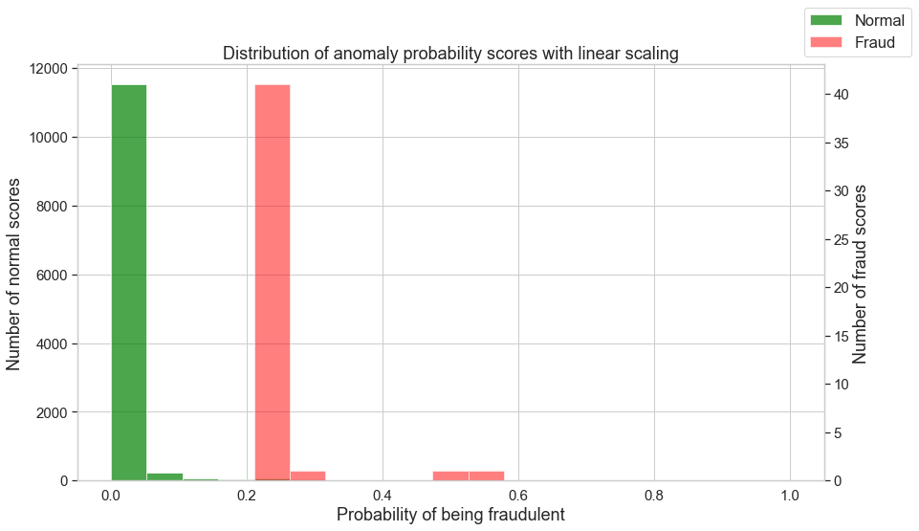
Linear Scaling
Standard linear scaling of the anomaly scores again provides a confusing distribution of scores.

Slide 29
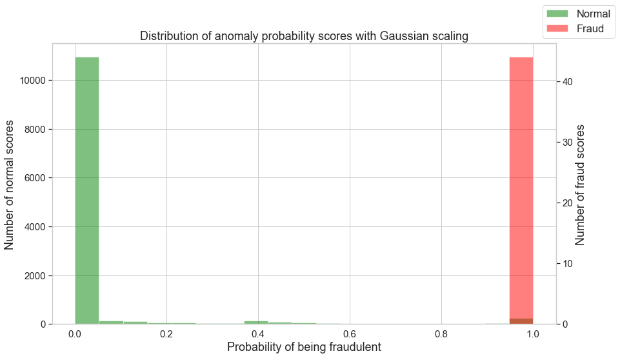
Gaussian Scaling
Gaussian scaling works well, with more green (normal) records appearing in the largest green bin (far left)

Slide 30
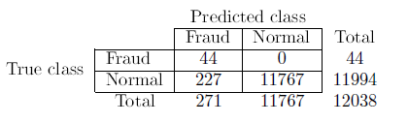
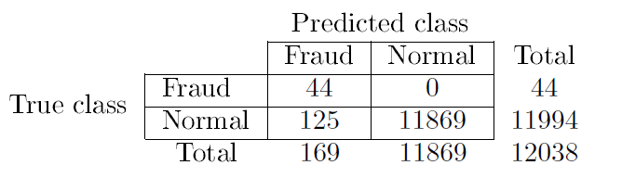
Performance Metrics
Directly comparing the passes of the unified approach can be done via a confusion matrix.
The initial/transactions-only model captures all of the anomalies, while recording 227 false positives.
The second/(transactional + network metrics) model reduced the false positives down to 125.

Slide 31
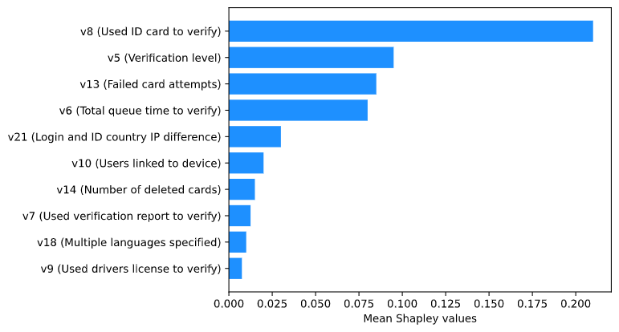
SHAP – Transactional Data
Applying SHAP on the initial model provided evidence that the following features where strong contributors in detecting anomalies data.
Examples include using a specific document type to sign up, having multiple card failures, and progressing through the signup process swiftly were some of the strongest.

Slide 32
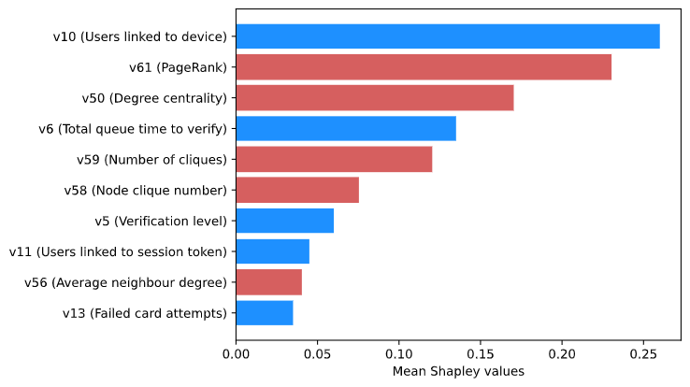
SHAP – Including Network Metrics
After including the network metric features, the second model presented a different picture, where 5 of the network metrics were strong contributors.
These include PageRank, degree centrality, # of cliques, clique number, and average neighbour degree.

Slide 33
Results and Discussion
Combining NAS and the 3 metrics for evaluation provides a formal method to support the architecture design decision.
Straightforward to implement, removes the subjective element of a visual threshold inspection.
Including the network metric features improved the balanced score for the optimal architecture from 89.76% to 94.07%.
When applied to a hold out test set, the inclusion of the network metric features reduced the false positive rate while not sacrificing precision.
Calculating the network metrics proved to be computationally expensive.

Slide 34
Conclusion
From a performance perspective, a more desirable outcome was achieved after introducing the network metric features, which effectively helped to reduce the number of false positives generated when using only the standard industry features.
The network metrics features were considerably more complex to construct however, which would impact the ability to generate these features in a timeous manner in a real-world setting.

